Slide 1

NAAN MUDHALVAN PROJECT
ELECTRICITY CONSUMPTION
BY
K.SWAATHI

Slide 2
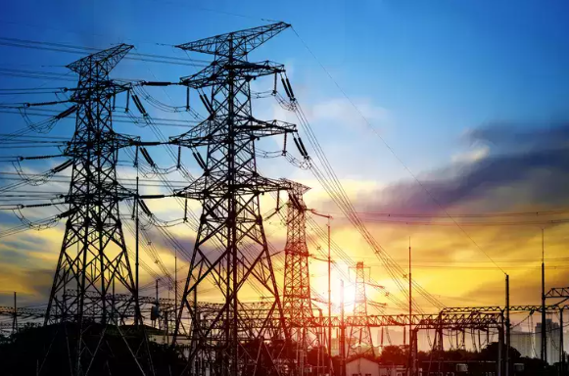
ELECTRICITY CONSUMPTION

Slide 3
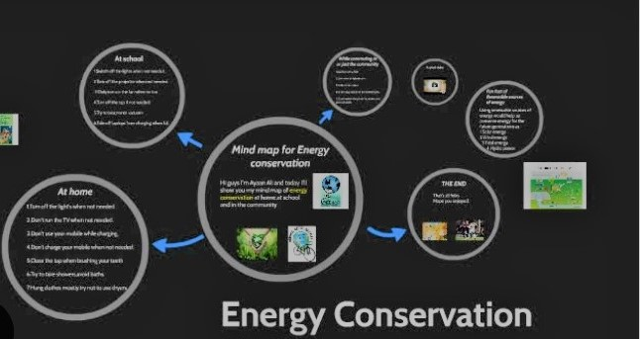
DEFINE PPROBLEM

Slide 4
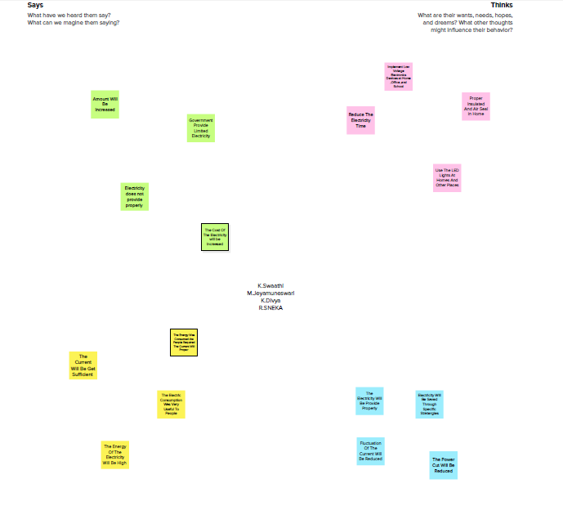
EMPATHY MAP

Slide 5
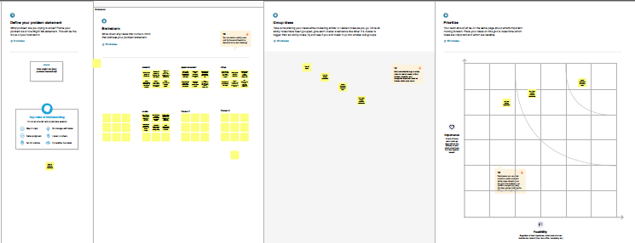
BRAIN STORMING & IDEATION

Slide 6
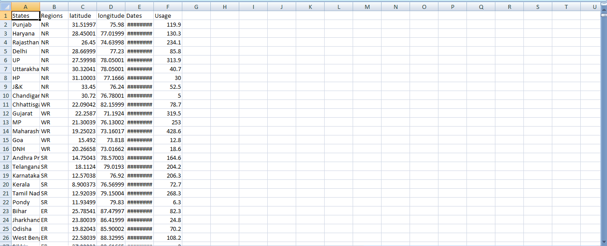
DATA COLLECTION

Slide 7
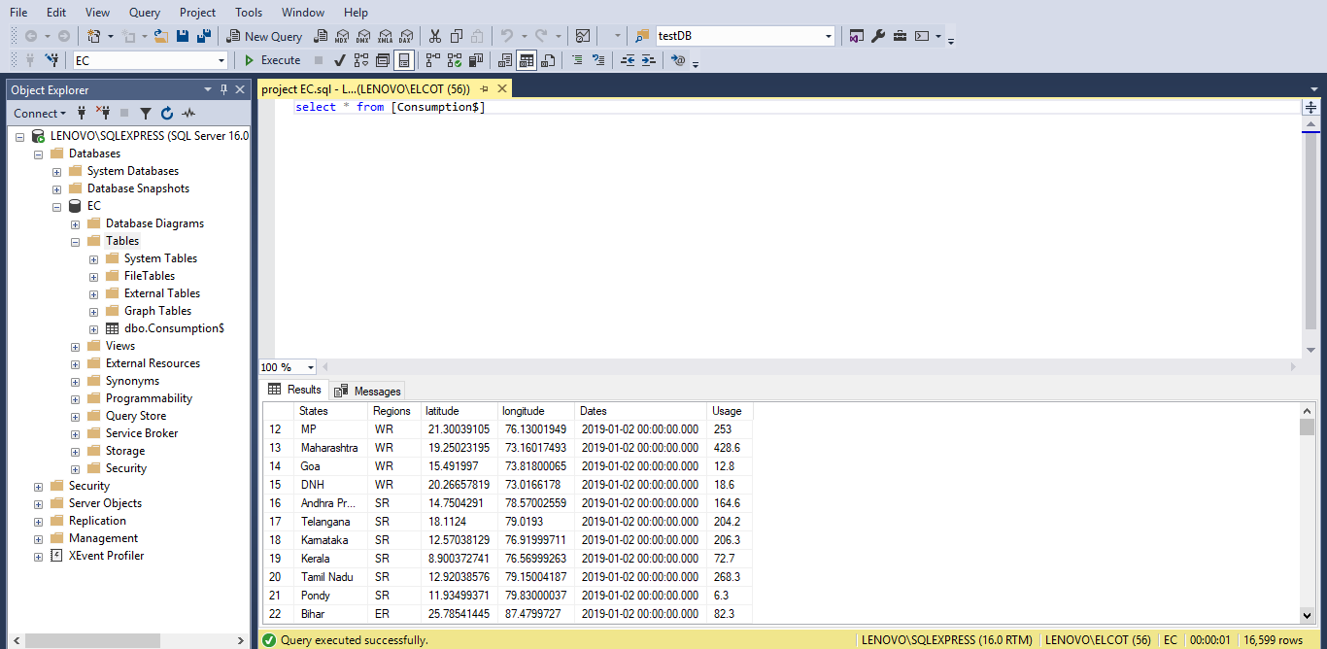
DATA PREPARATION

Slide 8
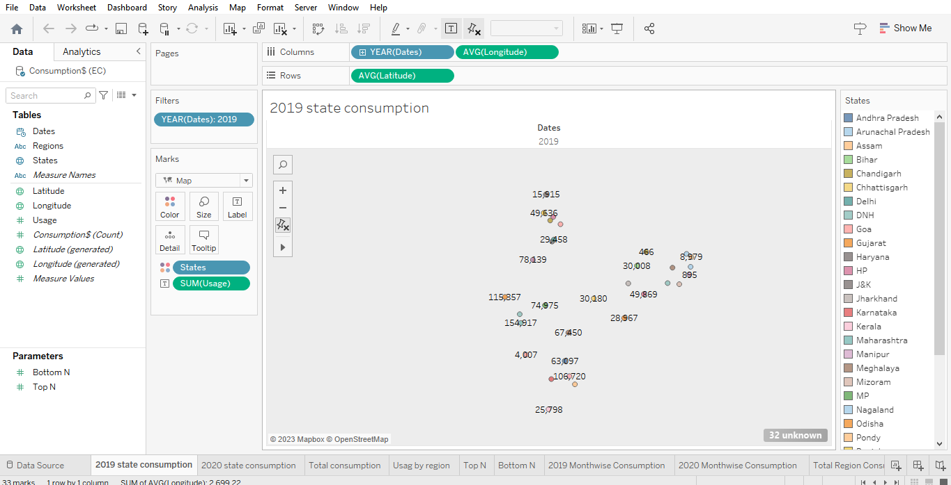
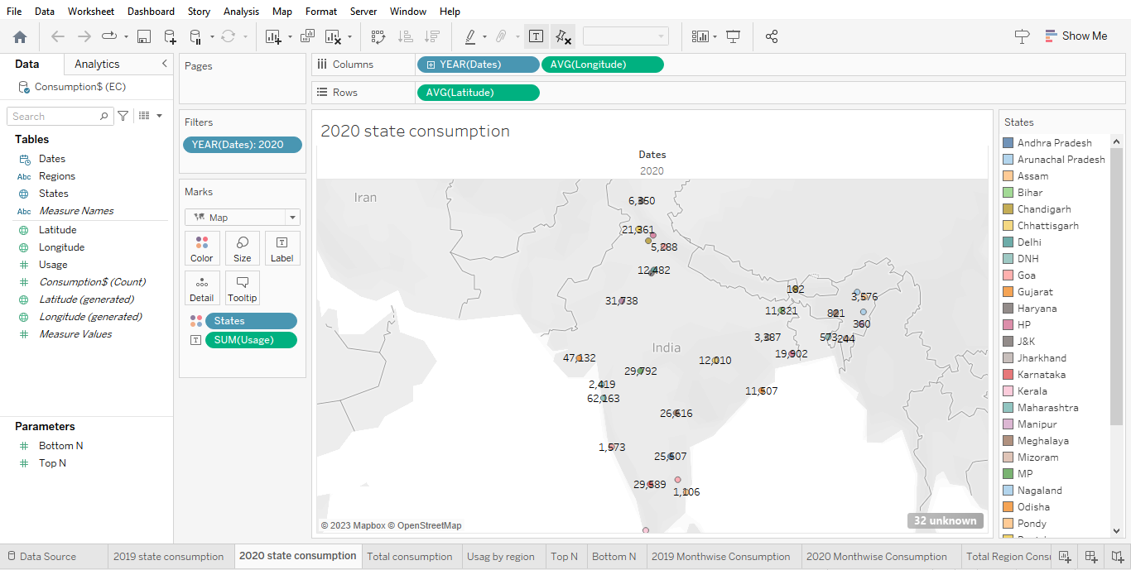
DATA VISUALIZATION EC SHEETS

Slide 9
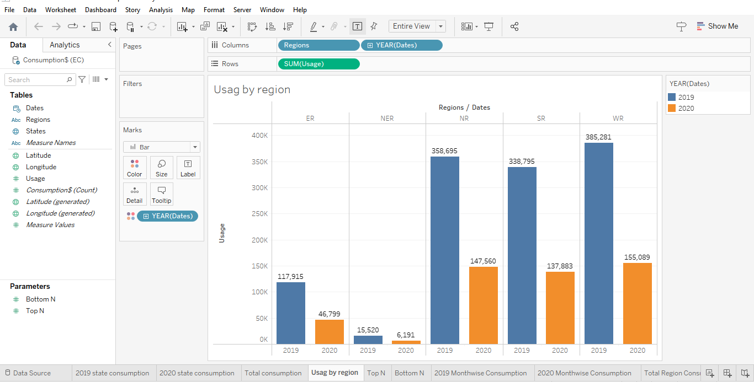
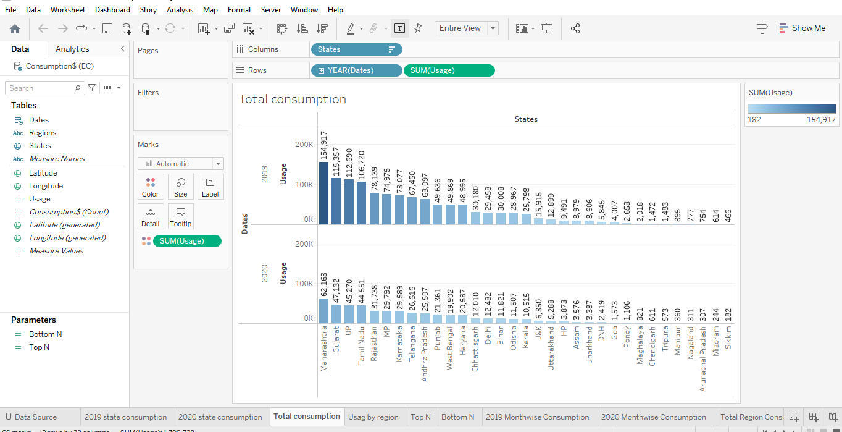
DATA VISUALIZATION EC SHEETS

Slide 10
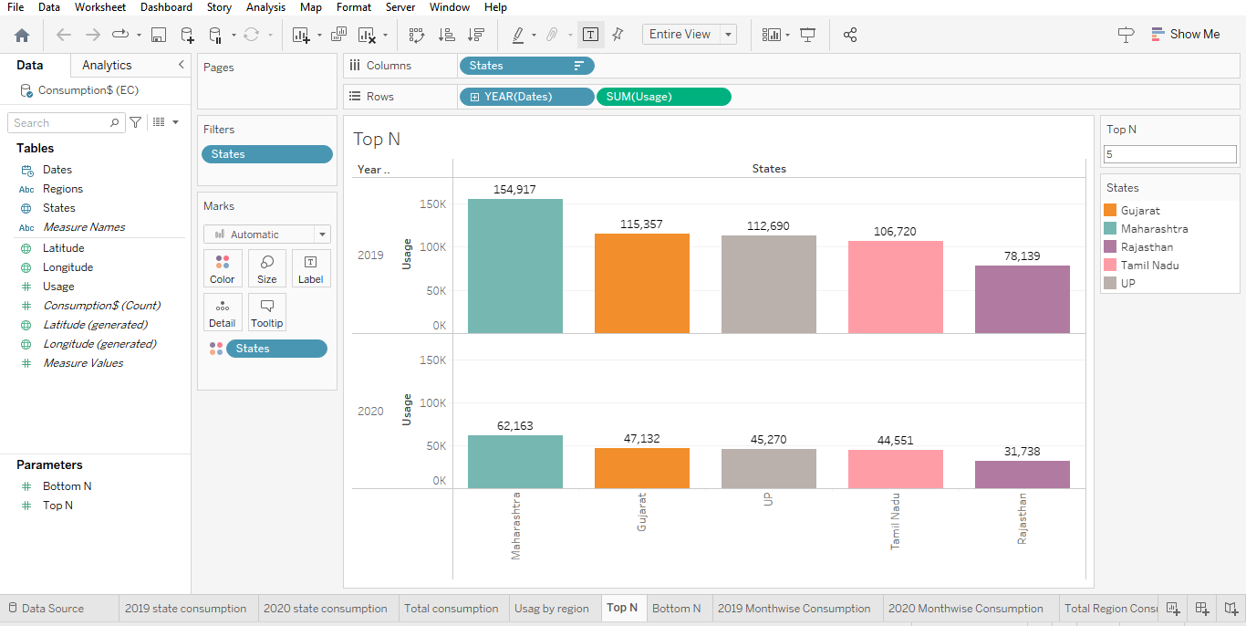
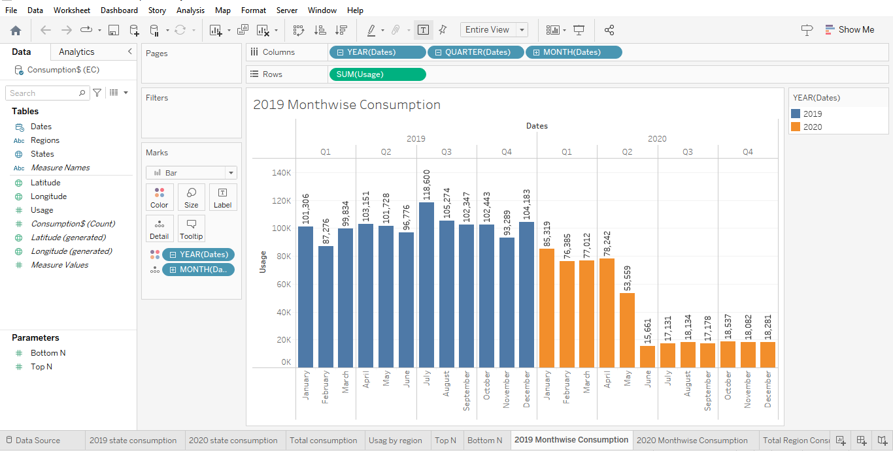
DATA VISUALIZATION EC SHEETS

Slide 11
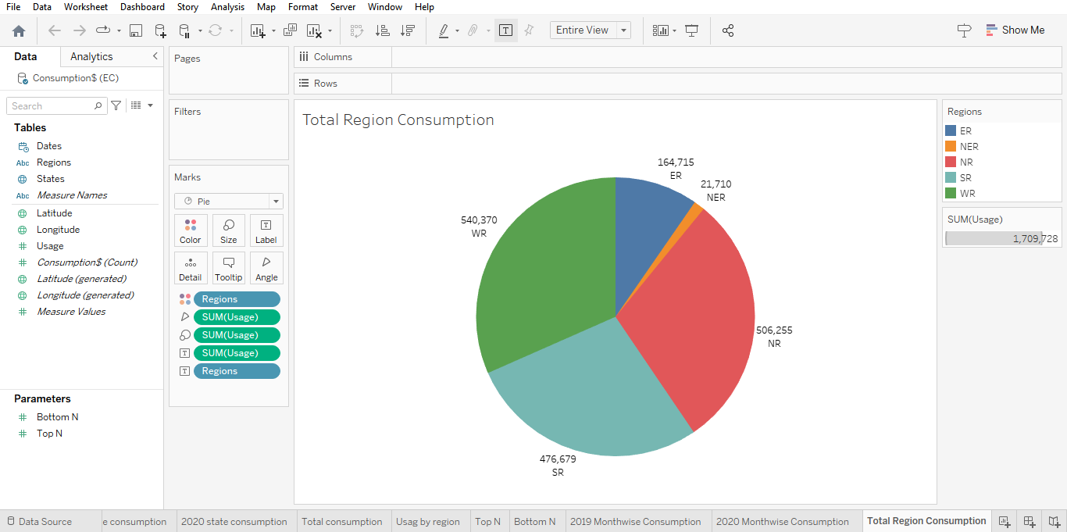
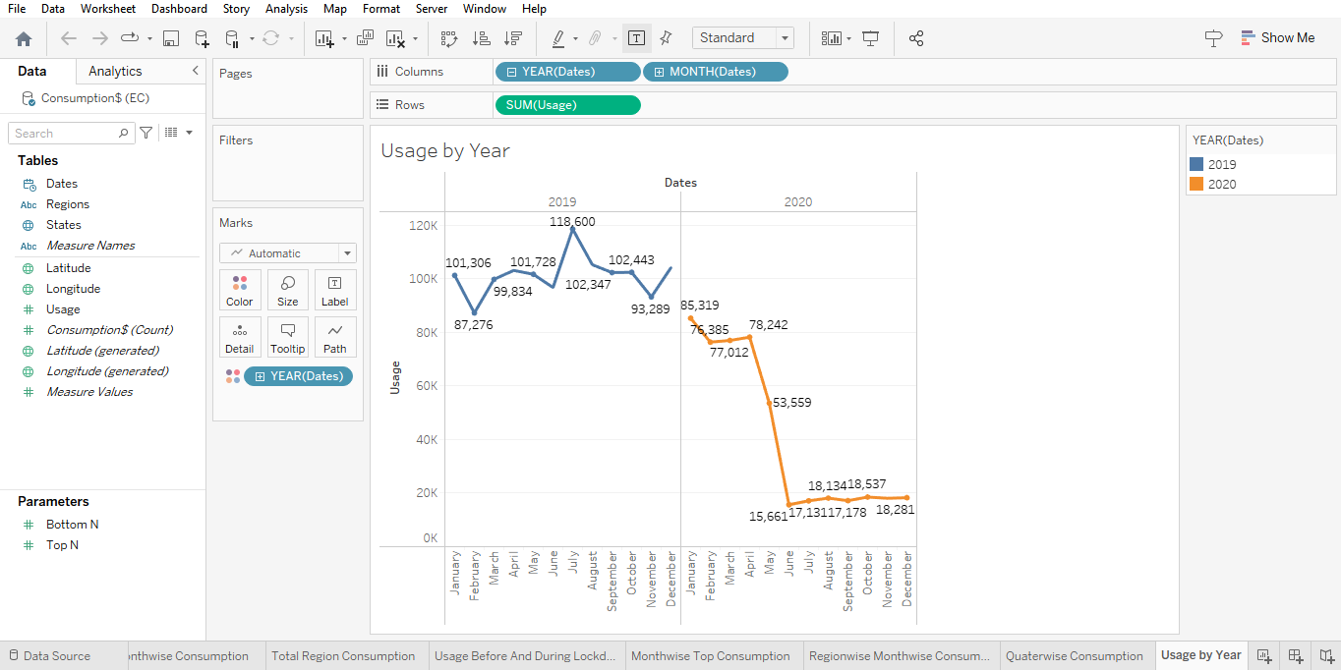
DATA VISUALIAZATION EC SHEETS

Slide 12
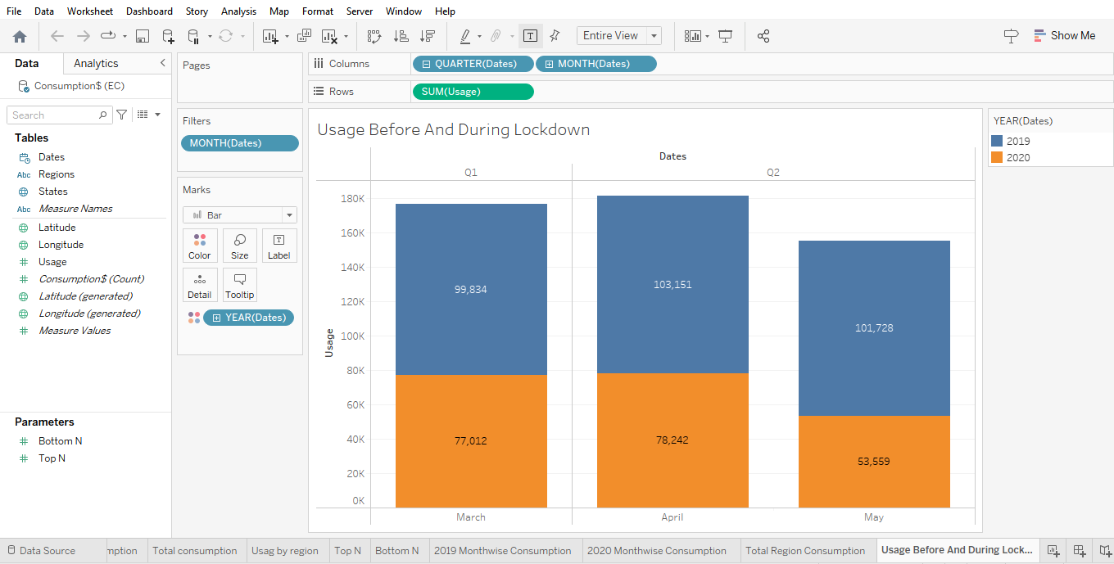
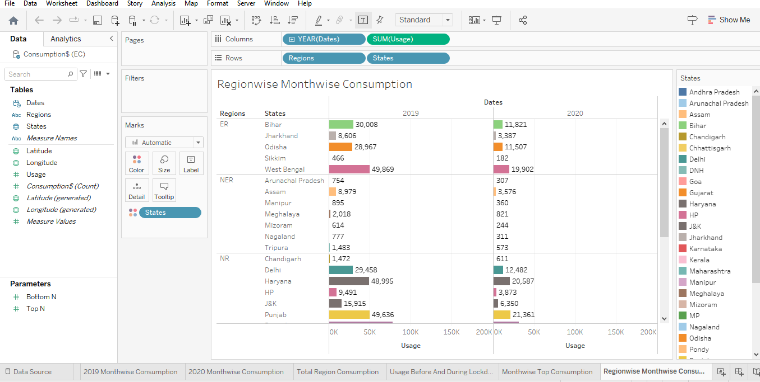
DATA VISUALIZATION EC SHEETS

Slide 13
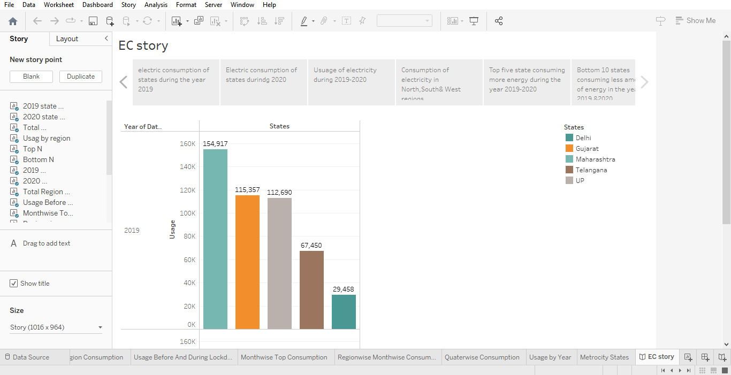
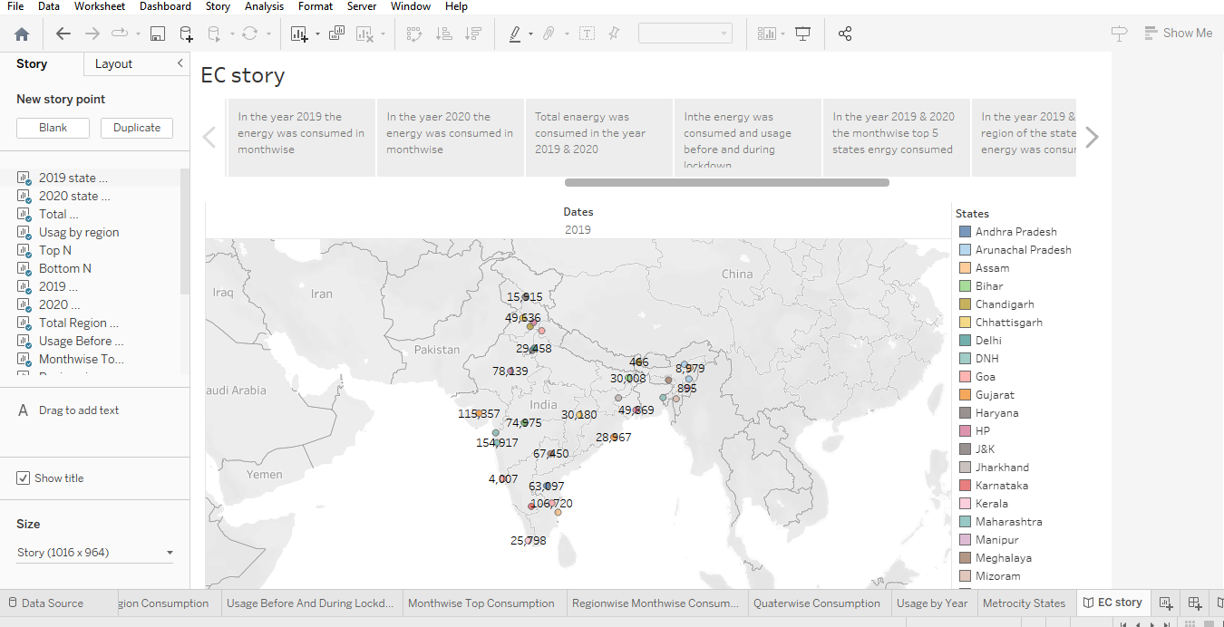
STORY EC STORY

Slide 14
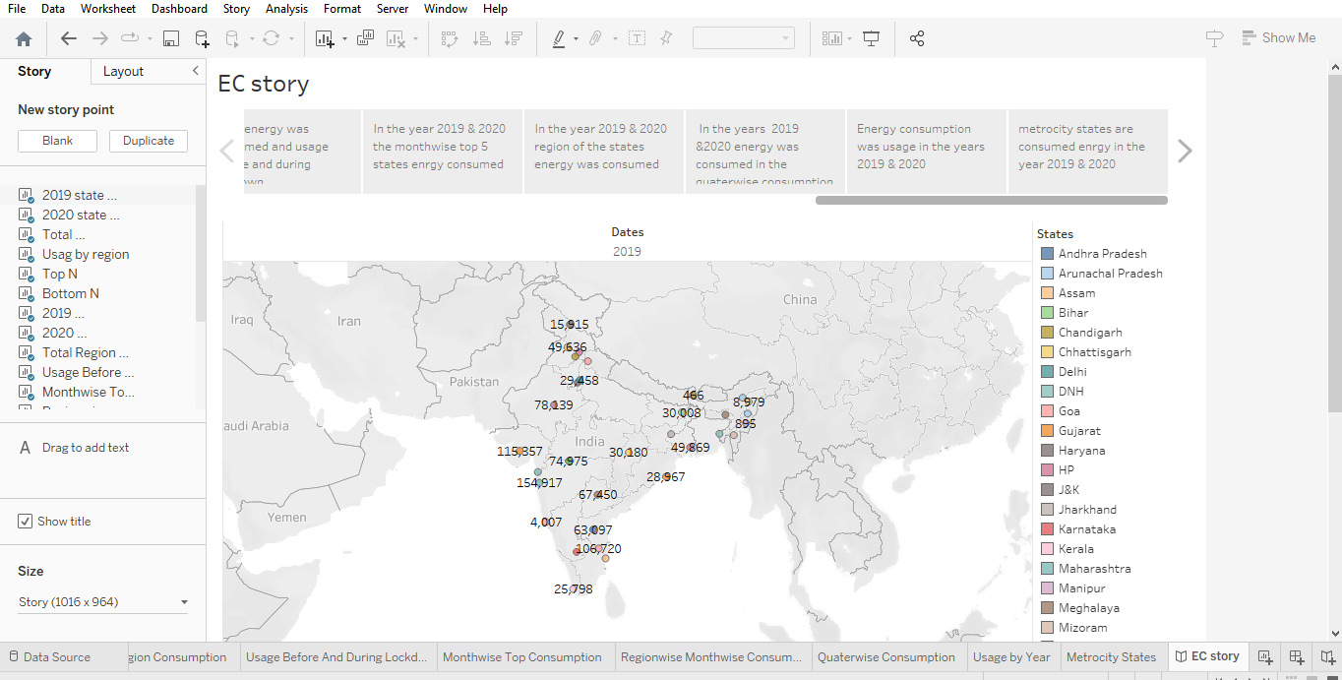
SRORY EC STORY

Slide 15
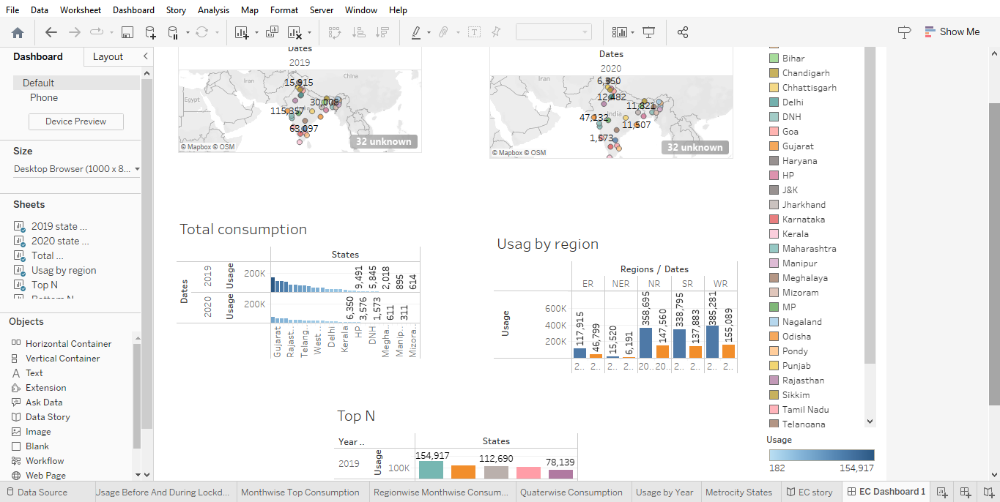
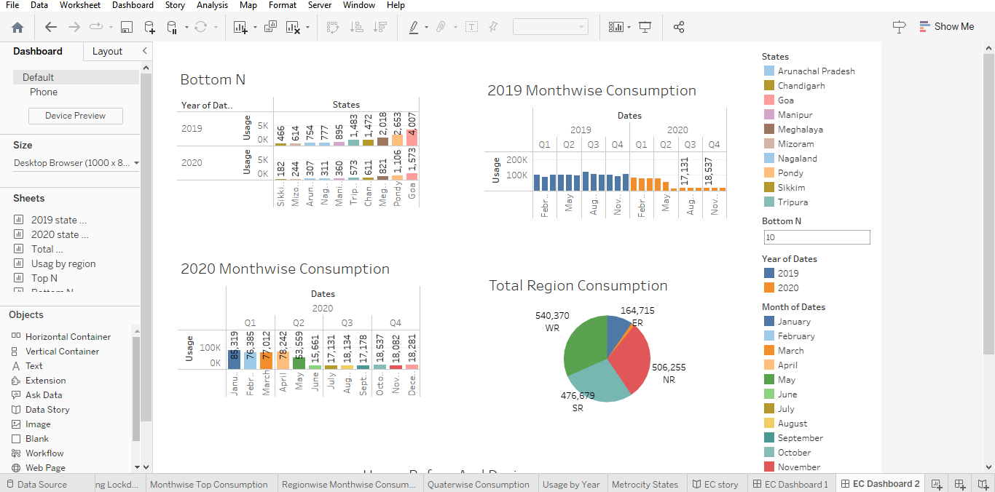
DASHBOARD EC DASHBOARD

Slide 16
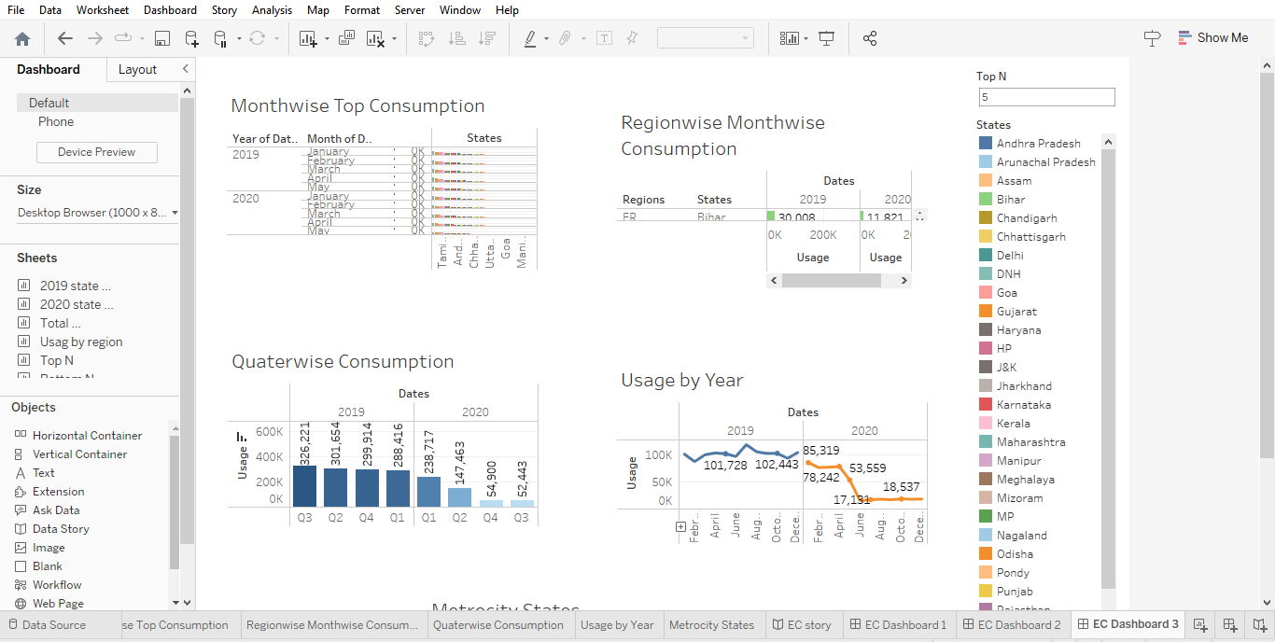
DASHBOARD EC DASHBOARD

Slide 17
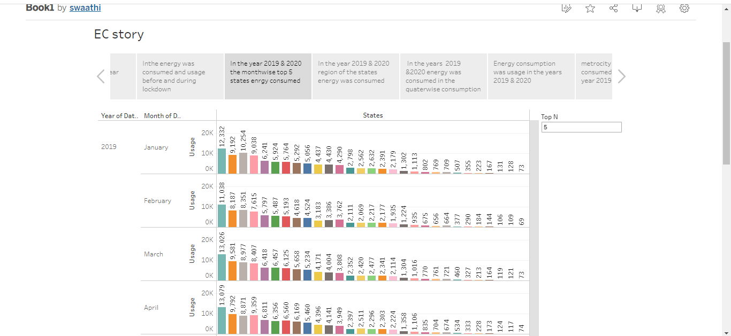
PERFORMANCE TASTNG EC DEMO STORY

Slide 18
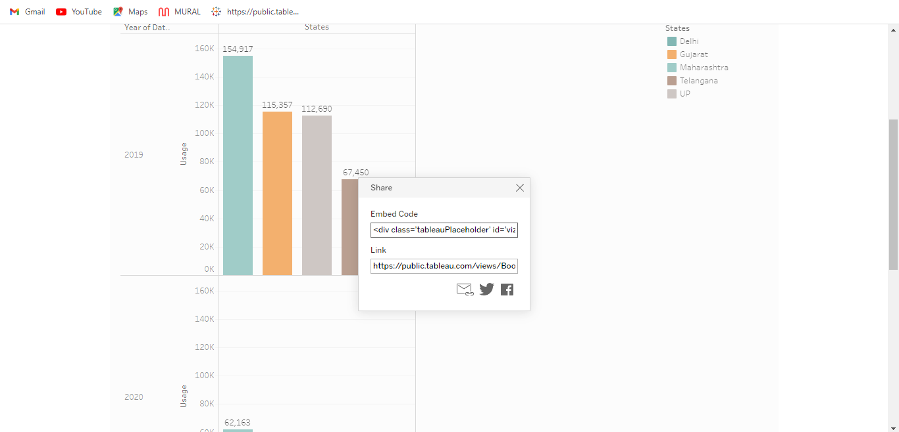
PERFORMANCE TESTING EC SHEET

Slide 19
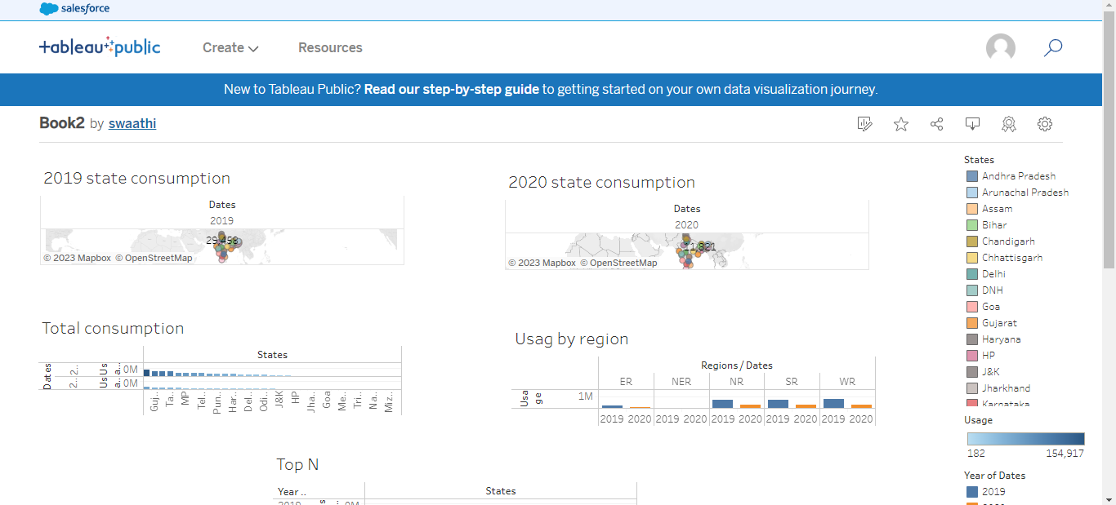
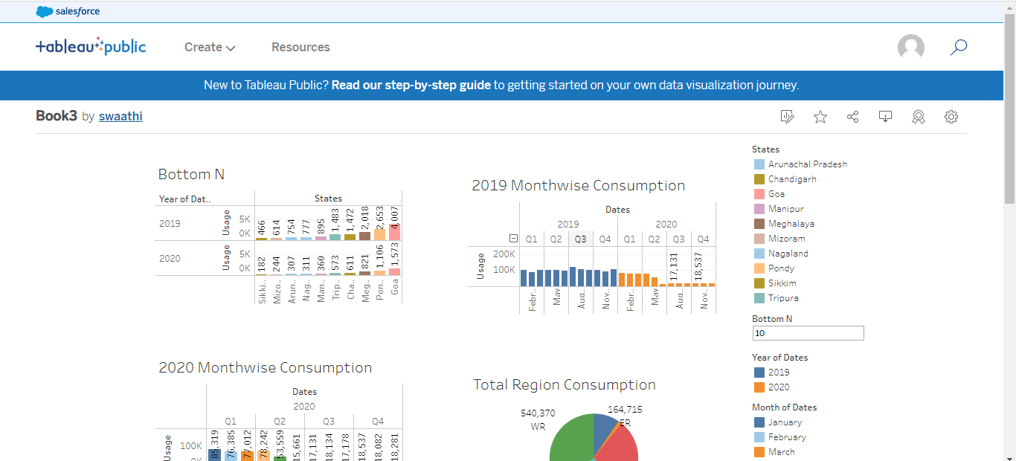
PERFORMANCE TESTING EC DEMO DASHBOARD

Slide 20
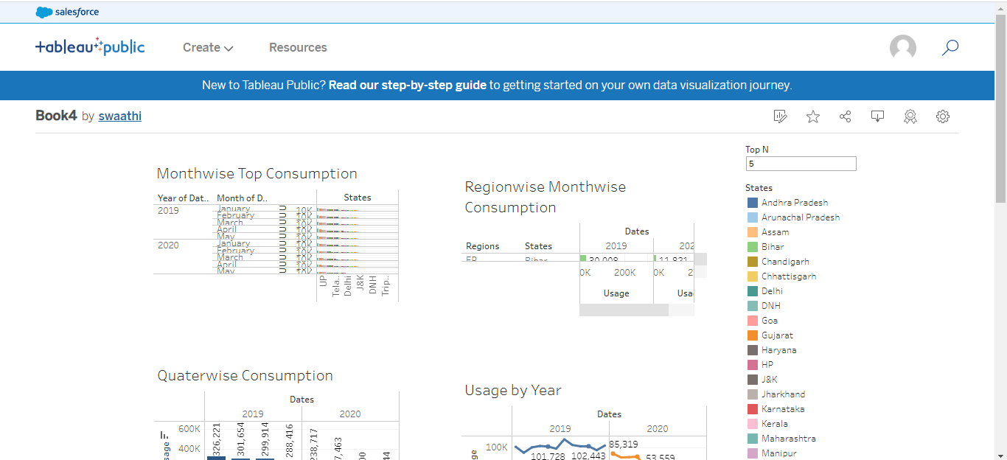
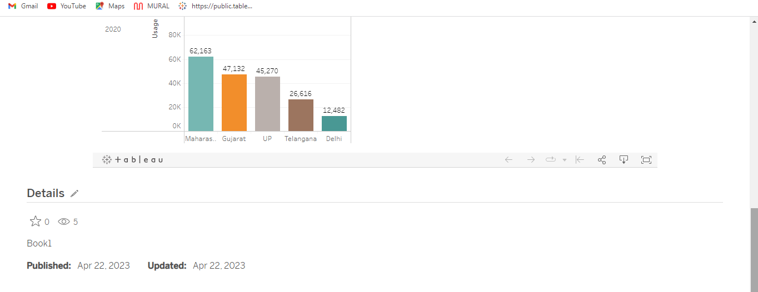
PERFORMANCE TESTING EC DEMO DASHBOARD

Slide 21
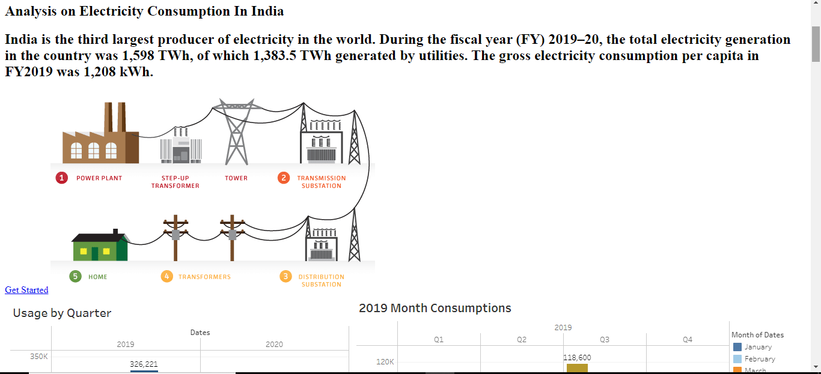
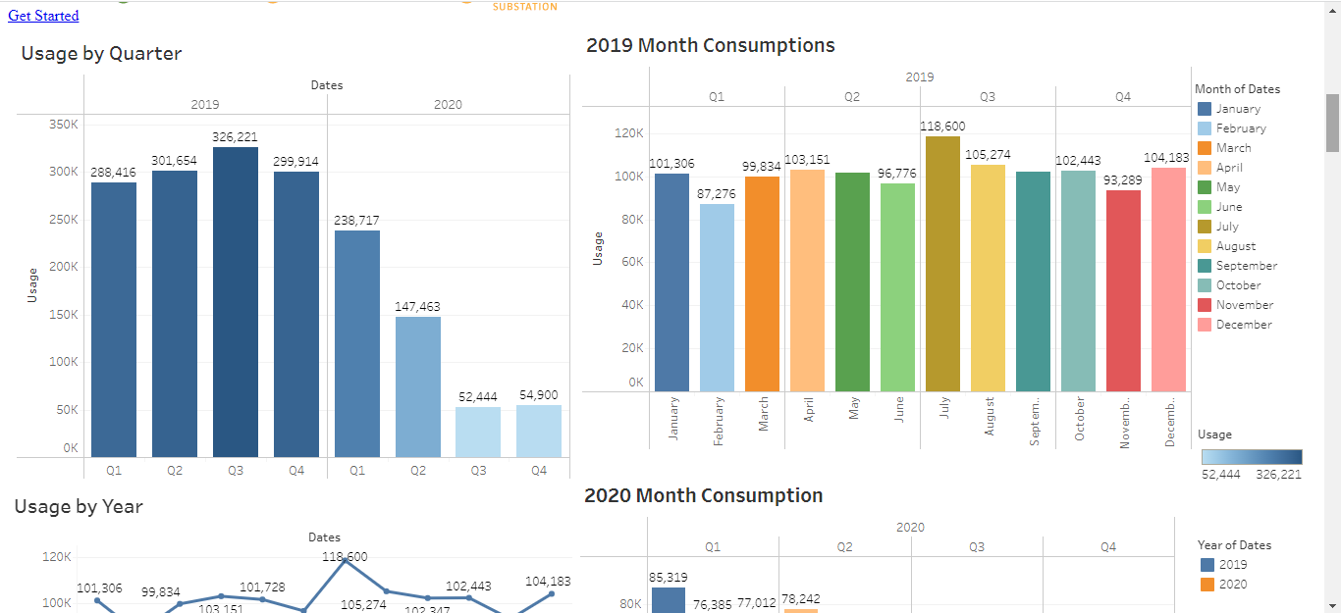
WEB INTEGRATION

Slide 22
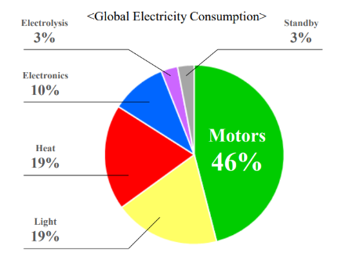
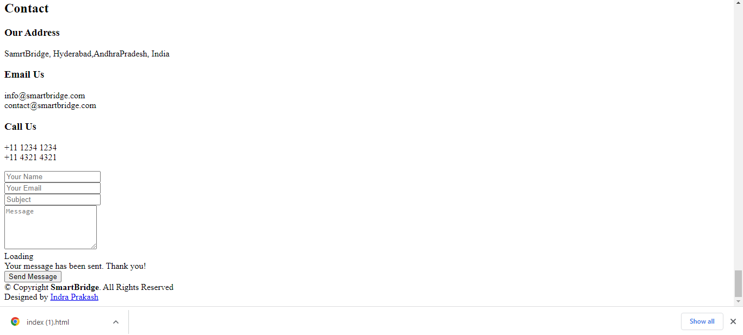
WEB INTEGRATION

Slide 23

TEAM LEADER: K.SWAATHI
TEAM MEMBERS:
K.DIVYA
M.JEYAMUNEESWARI
R.SNEKA
NMS SERMATHAI COLLEGE FOR WOMENS

